Slide 1
Application Types in Microsoft Identity
Notes:
In this unit, you’ll learn how to create, configure, and use Azure AD applications that use data returned from Microsoft Graph in single-page applications by using the OAuth 2.0 authorization code flow.

Slide 2

Overview
Single Page Apps (SPAs)
OAuth 2.0 authorization code flow
Azure AD app registration
MSAL & code configuration
Sign-in & obtain access token
Call APIs
Web Apps that call APIs
Daemon / Service Apps

Slide 3
Single Page Applications (SPAs)
Notes:
In this first section we’ll look at single page applications

Slide 4
Single Page Applications
Modern web applications can be built entirely client-side with JavaScript
Optionally leverage web framework (React, Angular, Vue, etc)
Run entirely in a web browser – no (or minimal) server-side component
Notes:
Web standards and modern browsers have advanced considerably in recent years to the point that developers can create sophisticated client-side applications. These client-side applications, also referred to as single-page applications (SPAs), can enable users to authenticate and obtain tokens from Microsoft identity platform that can be used to call secured web APIs.
Many modern web applications are built as client-side SPAs written using JavaScript or a SPA framework such as Angular, Vue, or React. These applications have traditionally used the OAuth 2.0 implicit flow to authenticate and obtain an access token to connect to protected services.

Slide 5
OAuth 2.0 implicit flow and authorization code flow
Implicit flow uses iframes and cookies for silent single sign-on. Many modern browsers block third-party cookies
Implicit flow exposes the access token
Authorization code flow addresses these issues
Microsoft identity platform supports both but authorization code flow is recommended
Notes:
The pattern used to implement the implicit flow in SPAs included the use of iframes and cookies for silent single sign-on in the browser. However, many modern browsers now block third-party cookies which breaks that implementation. That fact, along with concerns about the visibility of access tokens when using the implicit grant flow, lead to the decision to move to using the OAuth 2.0 authorization code flow for SPAs.

Slide 6
MSAL JS
MSAL.js 1.x only supports use of implicit flow
MSAL.js 2.0 (released July 2020) supports use of authorization code flow
Notes:
The easiest way to use Microsoft identity for authentication and to obtain access tokens to authorize requests to secured endpoints in SPAs is to use the Microsoft Authentication Library (MSAL) for JavaScript.
MSAL.js 1.x only supports the use of the implicit flow. However, in July 2020 Microsoft released MSAL.js 2.0 which supports the use of the authorization code flow. The remainder of this unit and the following exercise focus on MSAL.js 2.x and the use of the authorization code flow.

Slide 7
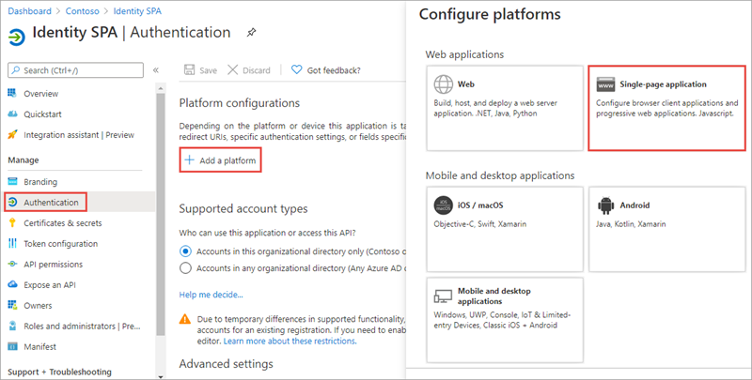
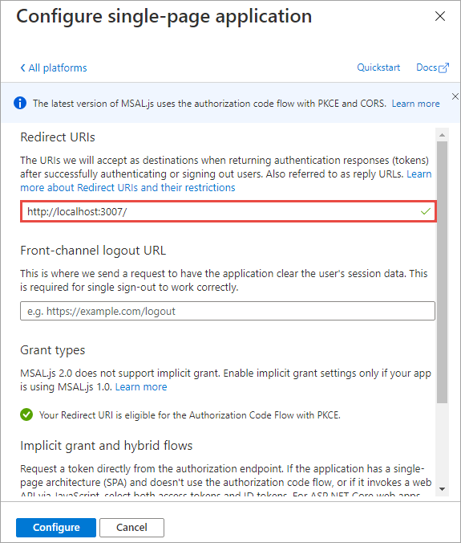
Azure AD app registration
SPA must have an associated Azure AD app registration to support user sign-in & obtain access token
Notes:
In order for a SPA to use Microsoft identity to enable users to authenticate and obtain access tokens for use with services such as Microsoft Graph, you must register a new app with Azure AD. You can do this using the Azure AD admin center https://aad.portal.azure.com.
After the application has been created, configure it to use the Single-page application platform.
Next, ensure the redirect URI of the app points to the URL of the SPA. This URL must match the redirect URL provided by the SPA when the authentication process is initiated.

Slide 8
MSAL JS Configuration
var msalConfig = {
auth: {
clientId: '{{AZUREAD_APP_ID}}',
authority: 'https://login.microsoftonline.com/{{AZUREAD_DIRECTORY_ID}}',
redirectURI: 'https://localhost:3007'
},
cache: {
cacheLocation: "localStorage",
storeAuthStateInCookie: isIE || isEdge
}
};
var msalApplication = new msal.PublicClientApplication(msalConfig);
Notes:
Load the MSAL.js 2.x library from the Microsoft-hosted content delivery network (CDN):
After adding the script reference to the page, add the following code to obtain an instance of the application:
The app ID and directory ID tokens in the code are placeholders for the values from the Azure AD app.

Slide 9
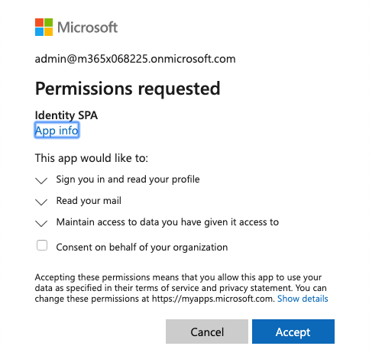
User Sign-in
var graphConfig = {
requestObj: {
scopes: ["user.read", "mail.read"]
}
};
msalApplication.loginPopup(
graphConfig.requestObj)
.then(handleResponse)
.catch(function (error) {
console.log(error);
});
Notes:
With the application configured, the next step is for the user to sign in. Do this by calling the `loginPopup()` method and pass in an object with the wanted permissions defined:
This code will open a popup that loads the Azure AD sign-in experience. If the user hasn't signed in previously and granted the app the specified permissions, after a successful sign-in, Azure AD will present the user with the consent experience.
After completing the sign-in experience, MSAL.js will close the sign-in popup and execute the success path of the `loginPopup()` method.
[!IMPORTANT]
The preferred experience when using MSAL when signing-in and obtaining access tokens is to use a popup window. However, some browsers have known issues with popup windows. In these cases, you can choose to use MSAL's equivalent methods that use browser redirects.

Slide 10
Acquire access token
var tokenRequest = {
scopes: ["user.read", "mail.read"],
account:
msalApplication.getAccountByUsername(
userEmail)
};
var accessToken = "";
msalApplication.acquireTokenSilent(tokenRequest)
.then(function(tokenResponse) {
accessToken = tokenResponse.accessToken;
})
.catch(function(error) {
if (error instanceof
msal.InteractionRequiredAuthError) {
msalApplication.acquireTokenPopup(tokenRequest)
.then(function(tokenResponse) {
accessToken = tokenResponse.accessToken;
});
}
});
Notes:
After the user has signed in, the next step is to obtain an access token to use in the authorization header of the request.
There are two methods on the MSAL.js API that you can use for this task:
`acquireTokenSilent()`: If the user has already signed in and an interactive sign-in is not required, this method will return a response that includes the access token:
`acquireTokenPopup()`: if the `acquireTokenSilent()` fails and/or an interactive sign-in is required, you can use this method. It will combine the request to sign-in and obtain an access token in one step:

Slide 11
Calling APIs– Microsoft Graph
function getMessagesFromMSGraph(accessToken, callback) {
var endpoint = "https://graph.microsoft.com/v1.0/me/messages?" +
"$top=10&$select=subject";
var xmlHttp = new XMLHttpRequest();
xmlHttp.onreadystatechange = function () {
if (this.readyState == 4 && this.status == 200)
callback(JSON.parse(this.responseText));
}
xmlHttp.open("GET", endpoint, true);
xmlHttp.setRequestHeader('Authorization', 'Bearer ' + accessToken);
xmlHttp.send();
}
Notes:
Once your SPA has an access token, you can use it to call the secured endpoint, such as Microsoft Graph:

Slide 12
Demo

Slide 13
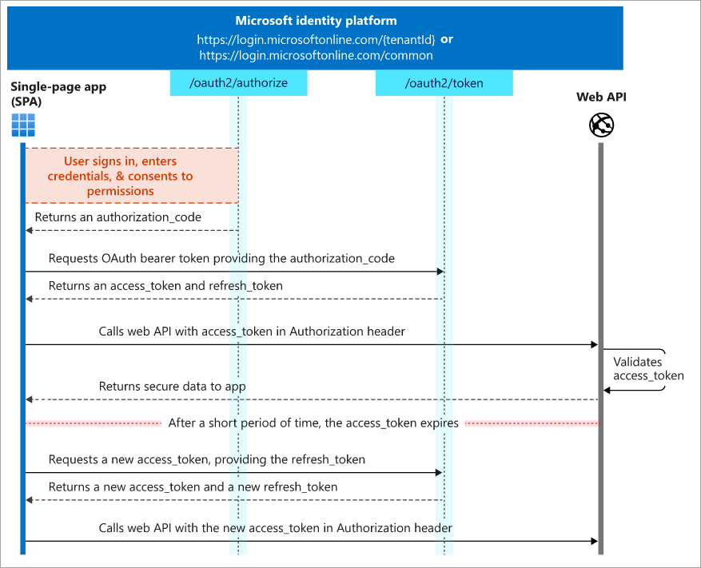
OAuth 2.0 auth code flow
Recommended way for SPAs to authenticate and obtain access token to connect to protected services
Supported by Microsoft identity platform
Supported by MSAL.js 2.x
Notes:
The OAuth 2.0 authorization code flow is the recommended way for these SPAs to authenticate to obtain an access token to connect to protected services. The Microsoft identity platform supports the OAuth 2.0 authorization code flow.

Slide 14
Thank you.

